Slide 1

NEC HACKATHON: TRANSPORT

Slide 2

TEAM NAME: NEXT TECH PROJECT NAME: HOP IN Team MEMBERS: SHIVANSH SHARMA, ARYAN PANDEY, DEVANSH SWARUP, PRASHANT GUPTA

Slide 3
hop in
An end to end travel solution
Theme
Transformation of public transport by using web or service applications to elevate user motivation.

Slide 4

Problems in existing transport facility

Slide 5






Problems Faced by traveller
Hyperlocal travel
Multiple booking
If a person has to travel from one place to other, He/she in turn has to make multiple travel bookings for different modes of transport.
Payment
He/she has to make multiple payments for each mode of transport he travels, and many a times in cash as digital payments are not supported.
Time taking
Multiple modes impose waiting at various stops to catch the next form of transport.
Incontinent
Going to the bus stop to catch the bus, even if he can catch the bus without going to the bus stop.
Crowd
Standing at bus stop, train station or subway cannot determine the crowd nor book his/her seat.

Slide 6




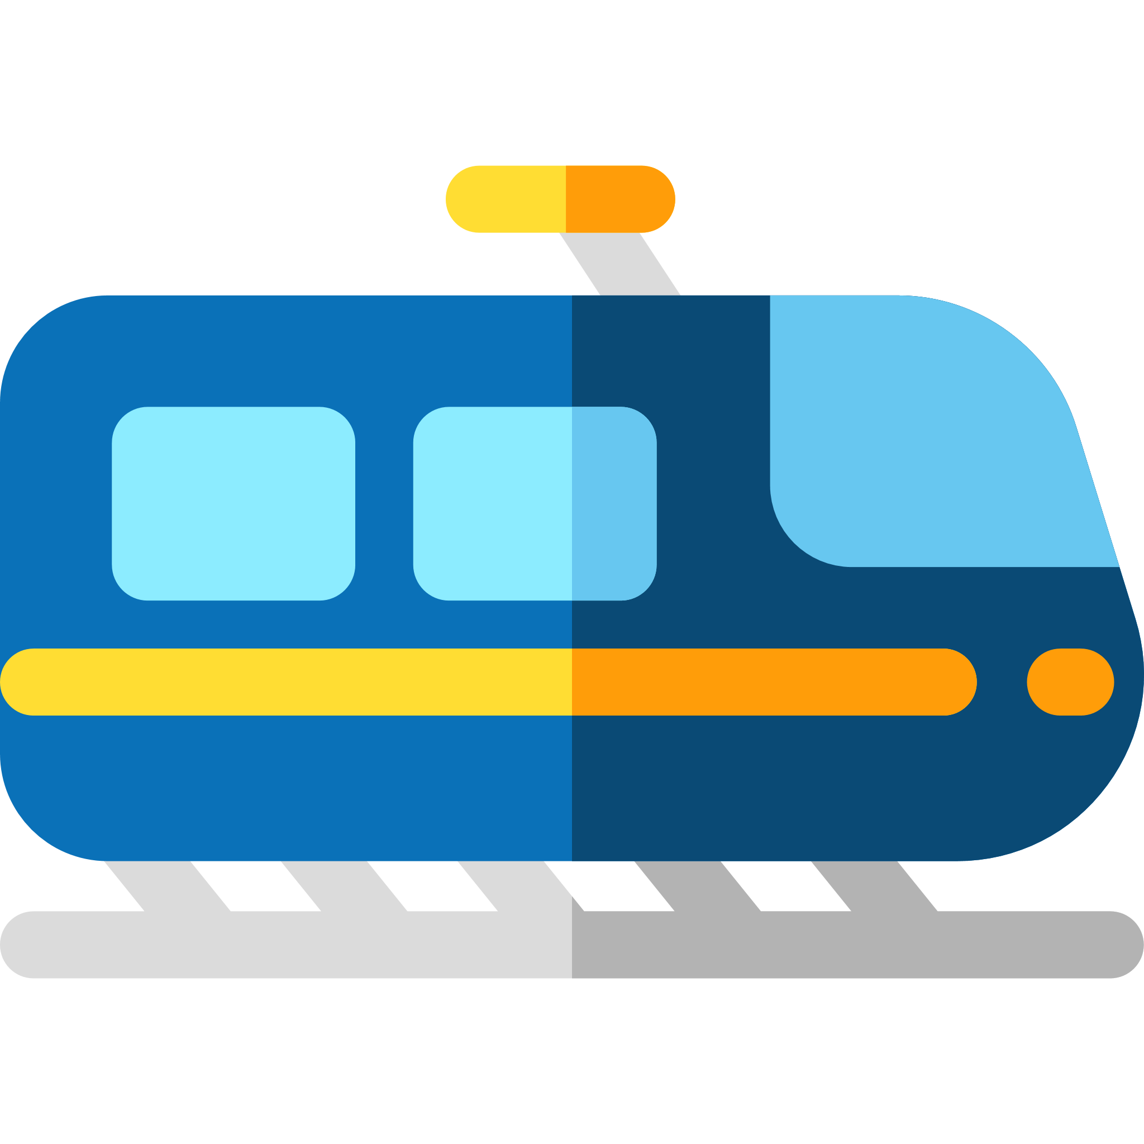






Addressing Problems
Hyperlocal travel
Imagine travelling to your place of work in the following manner-
You walk from your house
To the bus stand
The bus is running late, you waste your time at the bus stand
You get on the
metro
The bus arrives overcrowded
and you travel inconveniently
Now you are running late waiting at the subway
Conclusion
Minimum comfort while travelling
Time is wasted
Payment at each step
The cab driver is stuck in
a jam and reaches late
to pick you up
You finally reach your office late, exhausted and frustrated
You get down on the
subway and book a cab

Slide 7
Problems Faced by traveller
Domestic travel
Multiple bookings
If a person today wants to travel from one small town to other small town, he in turn has to make multiple travel booking for multiple means of transport .
Payment
Today a person making a travel booking has to pay high Convenience charges, if he makes multiple travel bookings
Time taking
Making multiple travel booking takes time.

Slide 8





Addressing Problems
Domestic travel
Travelling to other parts of country
You visit different
Website to find the
Flight details for your travel
After visiting websites you end up confused for best deals
You spend hours making
Multiple travel booking
You end up paying high
Convenience charges
Finally you get a confirmed travel booking
Conclusion
Multiple payment of Convenience charges
Time is wasted
You cant get the best deal possible each time

Slide 9
Problems Faced by travel companies
Supply & Demand
Travel companies these days are unable to track the supply and demand of there customers, and provide them with vehicles when needed the most.
Payment
Travel companies face problem in payments, dealing with fake currencies and change
Time taking
Travel companies face problem in allocating there resources to save time t stops

Slide 10


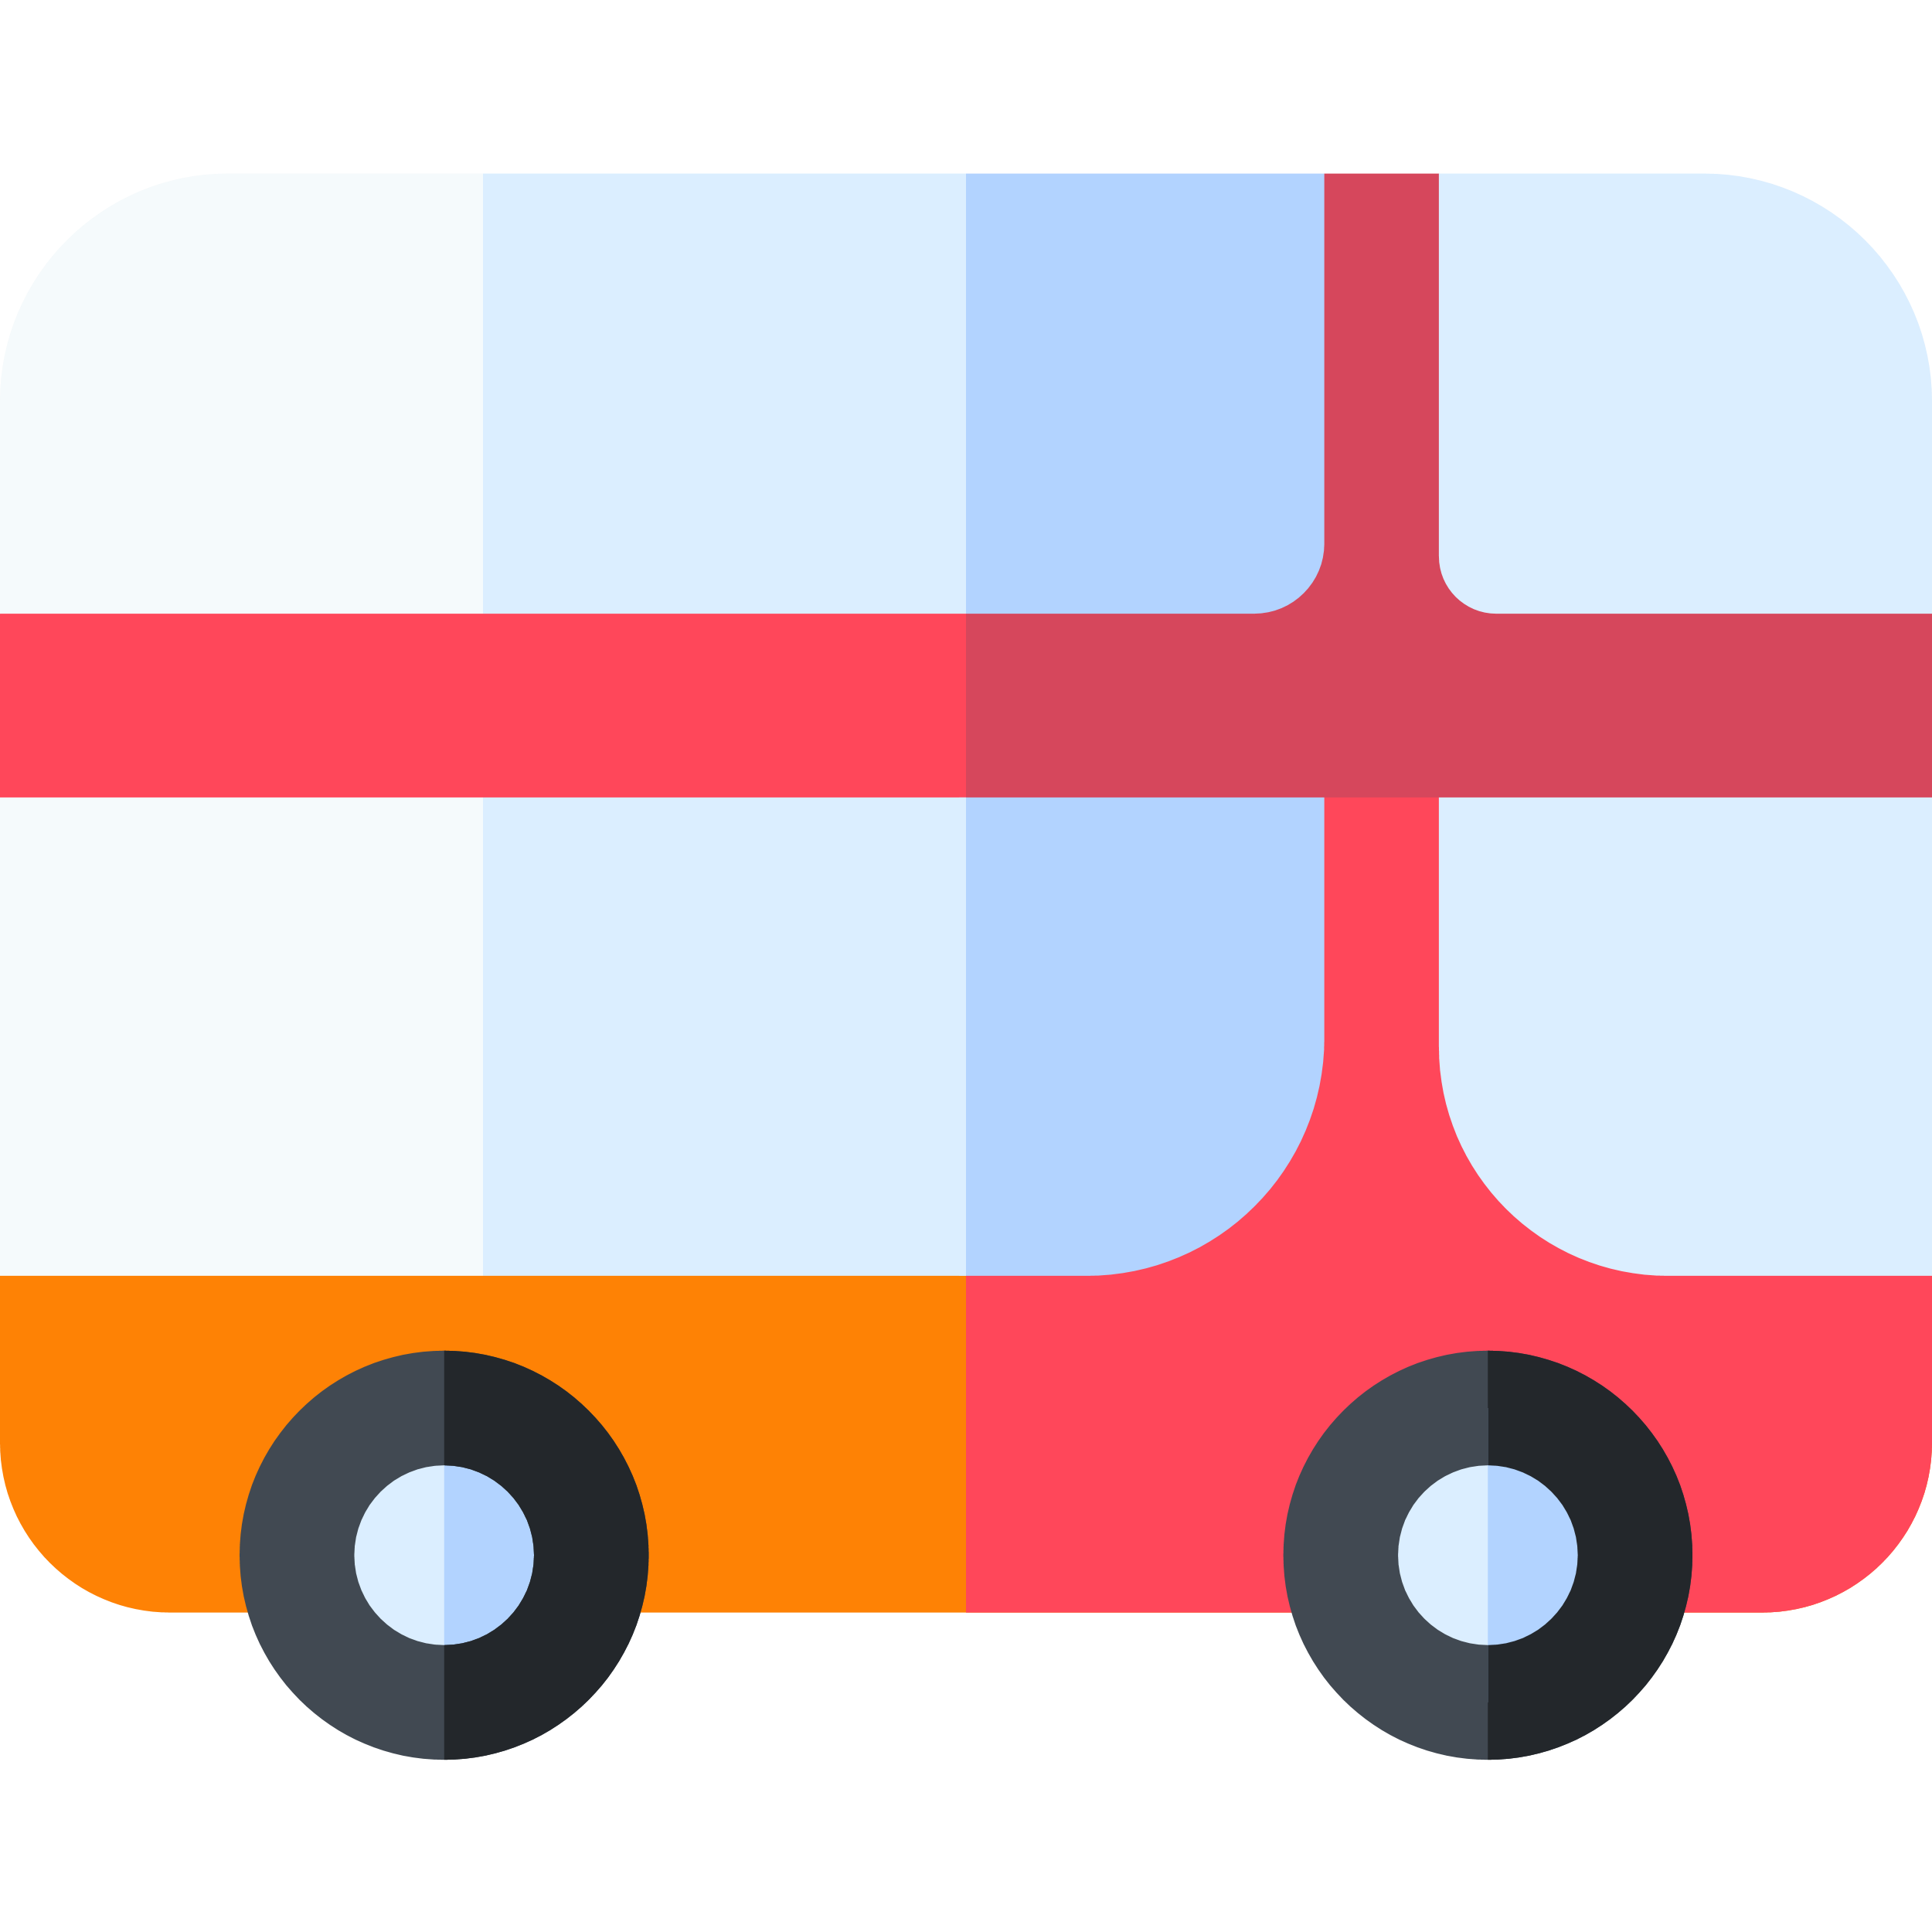

Addressing Problems
Travel companies
Problems faced by travel companies
Travel companies don’t have
Accurate information of
Supply and demand of
There transport.
High wait time for passengers
At stops.
Problem faced in payment process

Slide 11

Solutions to improve transport facility

Slide 12
hop in
An end to end travel solution

Slide 13
Solution for the traveller
Hyperlocal travel
Multiple booking
With HOP IN you can easily make multiple travel bookings from point A to point B, even adding intermediate stops from one website or app.
Payment
HOP IN is easy on payments, you just need to hop in and hop out of the vehicle without paying a single penny and you will be charged at the end of each day from your card.
Time
HOP IN uses a optimized algorithm to make travel bookings saving your time, and reducing your wait time.
Convenient
With HOP IN you don’t need to go to a bus stop to catch your bus and directly HOP IN the bus when it crosses you.
Crowd Information
HOP IN provides you with a real-time information about the crowd in the vehicle, giving you enough time to think, whether to board that vehicle or not.

Slide 14


Glimpse at our Solution
Hyperlocal travel
Imagine travelling to your place of work in the following manner-
Book your seat in your
preferred bus from
your place
Bus picks you up from your desired location
Hop out of the bus
without paying a single
penny
Reach the subway with a pre booked ticket with real time crowd info avoiding Queue
Reach the subway and
You have cab right there
to drop you
Conclusion
Maximum comfort while travelling
Time is saved
Payment is breeze
The payments will be deducted at the end of the day via contactless, hassle-free and automated gateways (done through NFC, Wi-Fi, Bluetooth) from the account specified by the user.
Reach your office with
Minimum wait time and maximum comfort

Slide 15
Solution for traveller
Domestic travel
Multiple bookings
With HOP IN you can easily make a travel booking from one place getting the best deal suited for your needs.
Payment
HOP IN is easy on Convenience charges, charging you just once for all your bookings.
Time Saving
HOP IN saves time for making travel booking providing all the travel deals at one place

Slide 16


GLIMPSE at our solution
Domestic travel
Travelling to other parts of country
HOP IN
You visit HOP IN
Website to make travel
Booking
HOP IN systems
analyse your request
And provide you with best options.
You Select a deal and pay a
Less convenience fee
You easily make
A travel booking
You enjoy your vacation
Conclusion
Onetime payment of Convenience charges
Time is Saved
You cant get the best deal in minutes

Slide 17
Solution for travel companies
Hyperlocal travel
Supply & Demand
Real time monitoring of supply and demand at various location optimising there business and maximising profits.
Payment
Travel companies can manage all there finances at one place accepting digital payments at end of each ride
Time
The resources and vehicles of travel companies can be optimised, by pre booking seats in the vehicle reducing wait time at stops

Slide 18
Key features of HOP IN
No unnecessary questions asked
Be it DOMESTIC or HYPERLOCAL travel, HOP IN is a breeze for the users, with no unnecessary or annoying questions asked. HOP IN just needs some basic details to get you going such as Starting point of travel, destination, date of travel
and number of passengers and rest of it is done by HOP IN , providing you with the best travel options available so that you travel flawlessly and in SYNC, with minimum wait time
Minimum wait time with all the private and public modes of transport are in SYNC
with each other
HOP IN uses a simple mechanism to plan your travel in such a manner that buses and cabs are always in sync with your travel at each step, information-tracking you down and with almost zero wait time.
Always being on places where you need them, be it airports, train stations or subway, providing the user with seamless travel.
Focus on digital payments
With HOP IN you can easily hop in and out of any HOP IN supported public transport without paying for your ride, and you will be charged for it after the day ends

Slide 19
Ethos of our model
Encapsulation: While conventional methods segregate your trip into multiple others whilst charging convenience fee for all of them, we charge it once and is usually less than the fore-mentioned.
Abstraction: The nitty-gritty of our mechanism, the constraints for the train and other public transport is solved with our algorithm and user input is never required in between.

Slide 20




Dependencies
Availability of internet services
Banking system
must be available
Availability of Server
Wireless Payment through Wi-Fi, Bluetooth or NFC

Slide 21
Focused Sectors
Public Transport
Travel Companies
Banking
Contactless payment providers and internet companies

Slide 22
Tech Stack
Front End
Angular
Backend Server
Flask
Frontend APIs
Google Maps
Mobile Application
Ionic

Slide 23
Summary
Our Idea is generalized for the audience, mainly targeting upon the public for a smarter way of travel, less constrained on both time consuming and smarter way to travel from public transport. The solution will encourage the audience to use public transport more conveniently and easily.
Today's Problem
For a comfortable journey requires pre-booking. A traveler must visit multiple places or websites to book for airplane, train, bus, and taxi separately.
Getting a good travel experience requires a convenient fee which charges a lot and includes middle man charges.
No such reliable public transport booking app or website is there to trace and book your journey easily.
Abstract of Idea
The idea is based upon the need of the public to get best travel experience with less hassle, convenient and best-priced fares. With the ability to live to track of the public vehicle before the journey begins. A smarter payment solution which can automatically make total journey fare based on government norms.
It’s for general public to book a journey through a bus, cab, auto, train or any other public transport at one go. The booking is very similar to today's booking app like Ola and Uber.
The solution will provide live tracking of the public transport, will provide better tracking and finding the transport before the journey begins.
The solution will (a) eliminate the middle men (b) provide a fast and reliable solution to book any kind of the public transport (c) provide a live tracking to the user. (d) provide a better and easy payment solution between the transport provider and user.

Slide 24

Contact us at
Email
shivanshsharma19980@gmail.com

Slide 25
The End

